Slide 1
Sentiment Analysis: Amazon Product Food Review
Ganesh Hedge 1MS12CS033
Charan Rao 1MS13CS406
Karthik M 1MS13CS407
Mithun R 1MS13CS414

Slide 2
CONTENTS
Project Goals
Description about data sets
Progress of the project
Description about the SRS
Description about the design with Class diagram and Sequence diagram

Slide 3
PROJECT GOALS
Food – A fact of life to improve the nutrition and health outcomes of populations.
It approaches to food safety and quality .
Recommending products to consumers means not only understanding their tastes, but also understanding their level of experience.
The food that is being tasted by the customer
on his opinion the review will be posted .

Slide 4
PROJECT GOALS
The Goal of this project is to find out which food is being praised or criticized by the
customer through review in one of the major
Food sites like Amazon.
Then the total number of customer’s review
Will be analyzed by sampling and then final outcome like is the product best to use or not? Will be produced at the end

Slide 5
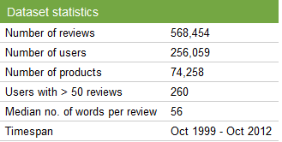
DATA SET DESCRIPTION
This dataset consists of reviews of fine foods from Amazon.

Slide 6
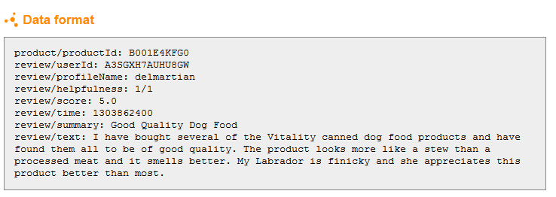
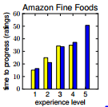
DATA SET DESCRIPTION

Slide 7
PROGRESS OF THE PROJECT
Amazon Food review Data Set Identification and Extraction
Pre-processing of data set
Removing unwanted attributes
Eliminating stop words
Stemming ( Porter’s algorithm)

Slide 8
DESCRIPTION ABOUT THE SRS
The SRS document enlists enough and necessary requirements that are required for the project development or analysis.
SRS helps in better understanding of the project by specifying the functional requirements, software system attributes etc.
It minimizes the time and effort required to analyse the data as the requirement are specified.
It also specifies system and hardware requirements.

Slide 9
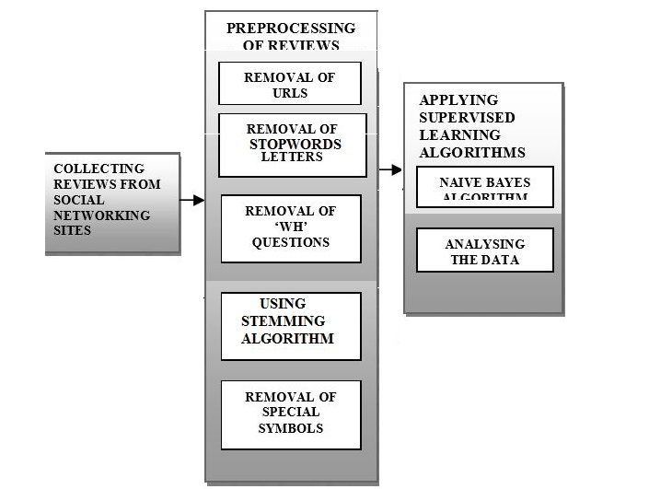

DESCRIPTION OF THE DESIGN
Amazon

Slide 10
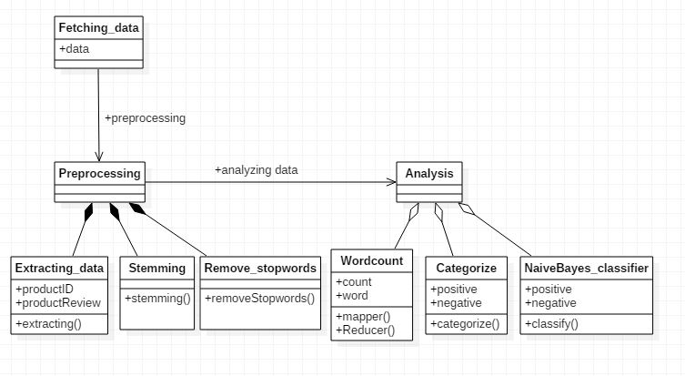
Class Diagram

Slide 11
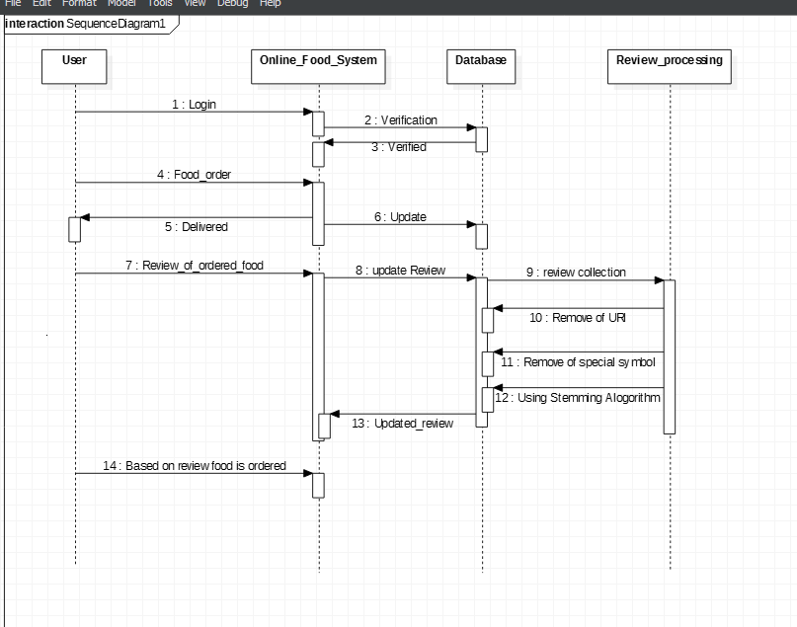
Sequence Diagram

Slide 12
Social Impacts
It creates a public awareness for the customer
about the products that is being reviewed.
It helps in fine tuning of the food products
It promotes the food product to be safety and healthy with no risks involved.

Slide 13
THANK YOU

